Slide 1
Data Analytics Project
Masai School
House Sales Analysis

Slide 2
Team Members
Golden Kumar
Sanket Kukwas
Vicky Khobragade
Suraj Kumar

Slide 3
Objective
The goal of this analysis is to predict the house pricing in King County, based on the attributes provided in dataset.
Implementation
Overview of data
Data Pre – Processing
Data Visualization
Prediction Modelling
Model Implementation

Slide 4
Data Pre-processing
Null Handling
Duplicate Removal
Noise Removal
Outlier Removal
Encoding & Scaling

Slide 5
Data Visualization
The below correlation table provides a summary of correlation between continuous variable in data.
The table helps to identify relation between potential predictors
If two predictors are highly corelated with each other they may explain a the same variation in the price table.

Slide 6
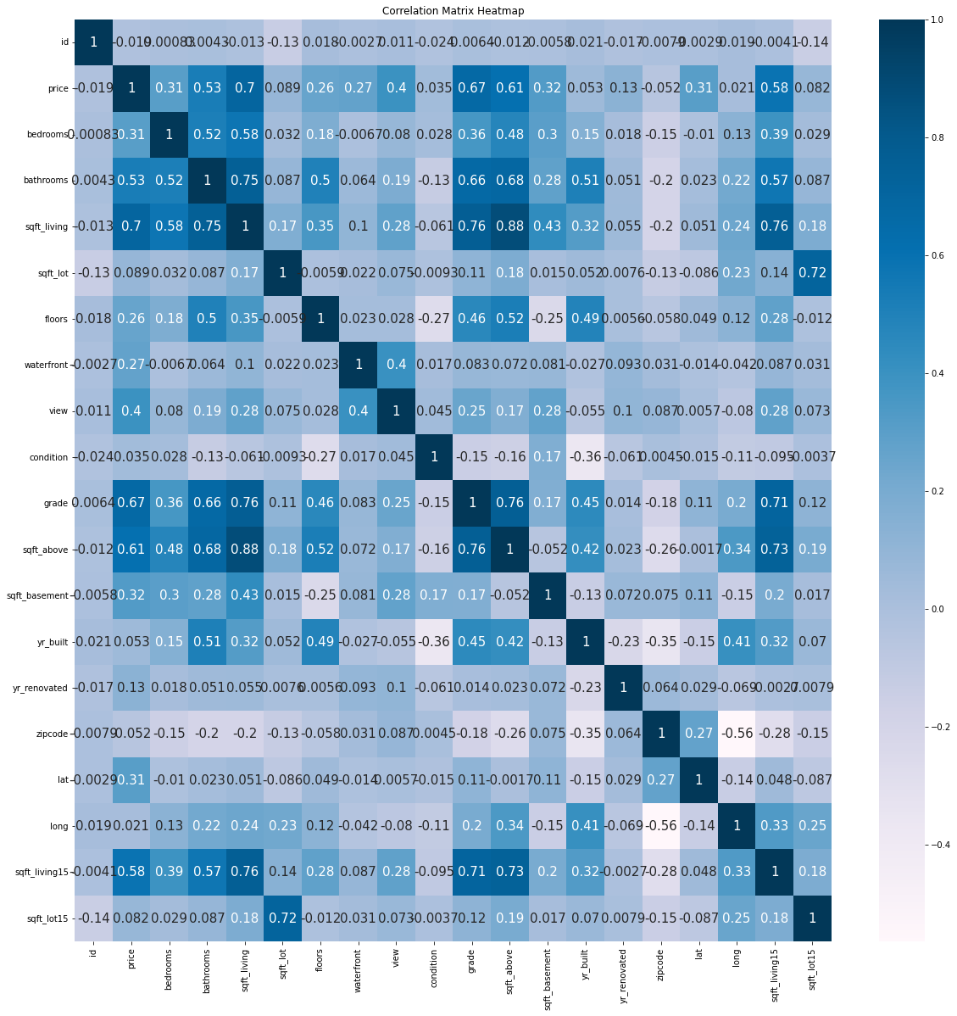

Slide 7
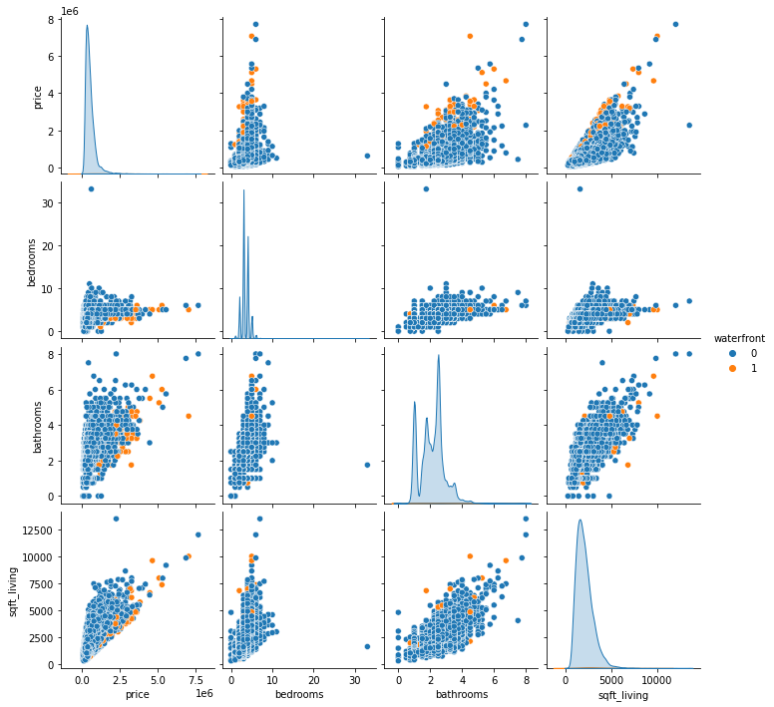
Pair Plot
Reason why we choose Pair plot
Pair plots are especially useful when we have a large number of variables in a dataset, as they provide a quick way to visualize the correlations between all the variables.
By examining the patterns in the off-diagonal plots, we can gain insights into the relationships between variables that may not be immediately apparent from a simple correlation matrix.

Slide 8
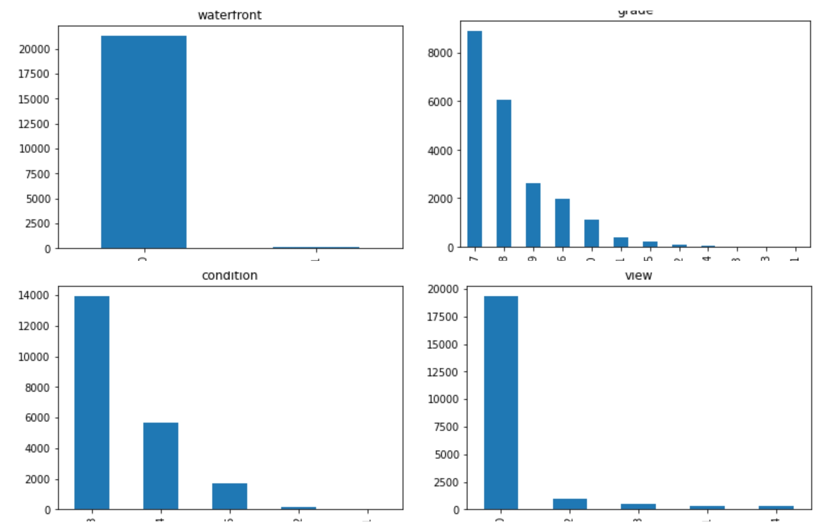
Histogram
Distribution of Categorical Variables

Slide 9
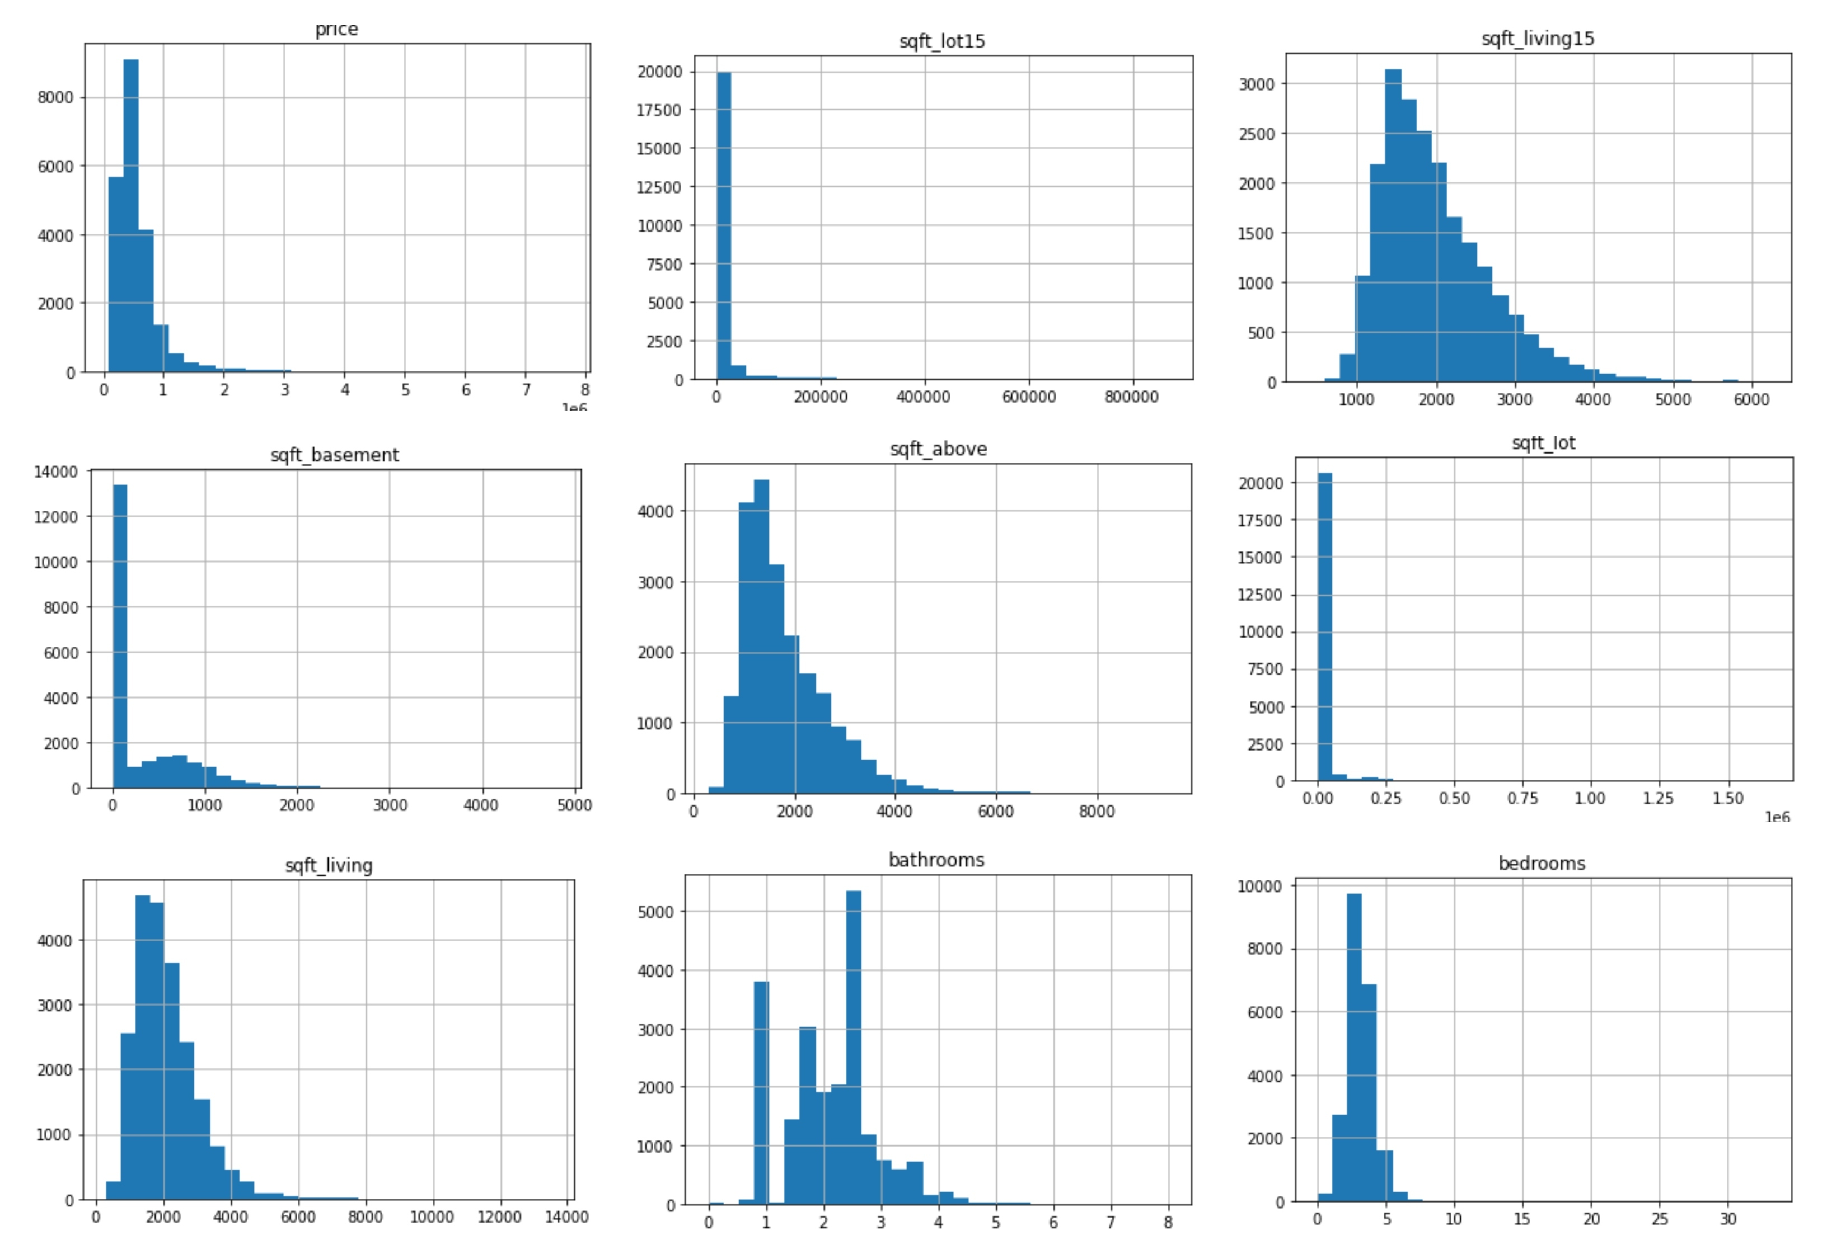
Histogram
Distribution of Numerical Variables

Slide 10

Chi-Square Analysis
Using the Chi-square test, we can estimate the level of correlation i.e. association between the categorical variables of the dataset. This helps us analyze the dependence of one category of the variable on the other independent category of the variable
The p-value will indicate whether there is a significant relationship between condition and grade. If the p-value is less than 0.05 (the significance level), we can reject the null hypothesis and conclude that there is a significant relationship between condition and grade.
View and Waterfront
Condition and Grade

Slide 11

Model Selection
We have trained our dataset on these 4 Models :
Linear Regression
Decision Tree
Random Forest
Support Vector Regression (SVR)
We have come to conclusion that Random Forest is best model because it has best RMSE. A lower RMSE value indicates that the model is making less error in its predictions, and is therefore better at predicting the outcome of interest.
On the other hand, a higher RMSE value indicates that the model is making more errors, and is therefore less accurate.

Slide 12

Model Selection
After removing column with high multi – collinearity and using Polynomial Regression with degree 2 and 3. We still found that in terms of RMSE Random Forest was the best model with high accuracy

Slide 13
Thank You

